Slide 1
CPT-S 415
Big Data
Yinghui Wu
EME B45

Slide 2
Data-driven Approximate Query Processing
“Big Data”
Query
Exact Answer
Long Response Times!
Compact
Data Synopses
“Small Data”
Query
Approximate Answer
FAST!!
KB/MB
How to construct effective data synopsis ??
Histograms, samples, wavelets, sketches, spanners, sparsifiers
Synopses for Massive Data: Samples, Histograms, Wavelets, Sketches, Graham, et.al http://db.ucsd.edu/static/Synopses.pdf

Slide 3
CPT-S 415
Big Data
Approximate query processing
Data-driven approximation
  Data synopses: Histogram, Sampling, Wavelet
  Graph synopses: Sketches, spanners, sparsifiers
A principled Big Data search framework: Resource bounded querying – deferred to BD theory; week 11
Notes:
Object.

Slide 4
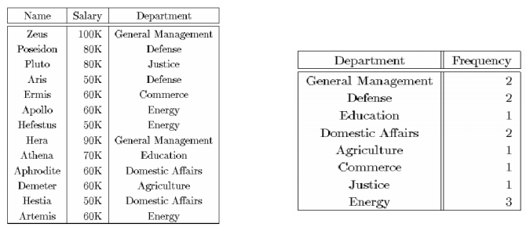
Histograms
Partition attribute value(s) domain into a set of buckets
Estimation of data distribution (mostly for aggregation); approximate the frequencies in each bucket in common fashion
Equi-width, equi-depth, V-optimal
Issues:
  How to partition
  What to store for each bucket
  How to estimate an answer using the histogram
Long history of use for selectivity estimation within a query optimizer

Slide 5
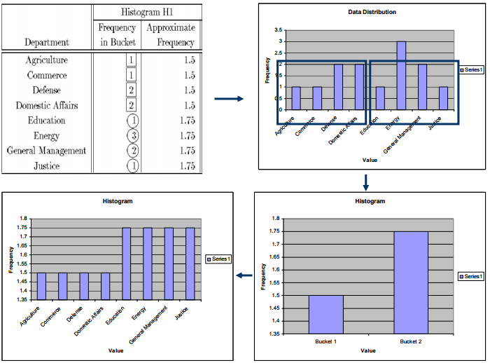
From data distribution to histogram

Slide 6
Equi-Depth
Count in
bucket
1 2 3 4 5 6 7 8 9 10 11 12 13 14 15 16 17 18 19 20
Domain values
Goal: Equal number of rows per bucket (B buckets in all)
Can construct by first sorting then taking B-1 equally-spaced splits
Faster construction: Sample & take equally-spaced splits in sample
  Nearly equal buckets
  faster algorithm: one-pass quantile
  “Space-Efficient Online Computation of Quantile Summaries”, Michael Greenwald, et al., SIGMOD 01
1 2 2 3 4 7 8 9 10 10 10 10 11 11 12 12 14 16 16 18 19 20 20 20

Slide 7
Equi-Depth
Count in
bucket
1 2 3 4 5 6 7 8 9 10 11 12 13 14 15 16 17 18 19 20
Domain values
Can maintain using one-pass algorithms (insertions only), or
Maintain a larger sample on disk in support of histogram maintenance
  Keep histogram bucket counts up-to-date by incrementing on row insertion, decrementing on row deletion
  Merge adjacent buckets with small counts
  Split any bucket with a large count, using the sample to select a split value, i.e, take median of the sample points in bucket range
Split
4 5 6 7 8 9
4 5 6 7 8 9

Slide 8
Answering Queries: Equi-Depth
  Answering queries:
    select count(*) from R where 4 <= R.A <= 15
    approximate answer: F * |R|/B, where
      F = number of buckets, including fractions, that overlap the range
      Error guarantee: ± 2 * |R|/B
    Answer: 3.5* 24/6 = 14; actual count: 13
      Error bound? 0.5*24/6 = 2
1 2 3 4 5 6 7 8 9 10 11 12 13 14 15 16 17 18 19 20
4 ≤ R.A ≤ 15
Answering queries from 1-D histograms (in general):
  (Implicitly) map the histogram back to an approximate relation,
  & apply the query to the approximate relation

Slide 9
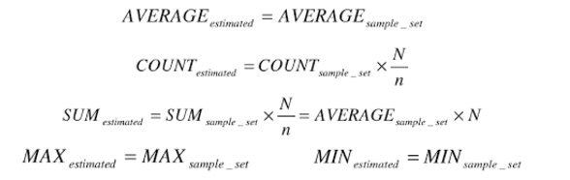
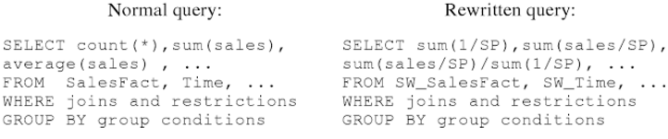
Sampling: Basics
Idea: A small random sample S of the data often well-represents all the data
  For a fast approx answer, apply the query to S & “scale” the result
  e.g., R.a is {0,1}, S is a 20% sample
  select count(*) from R where R.a = 0
  select 5 * count(*) from S where S.a = 0
1 1 0 1
1 1 1 1 0 0 0
0 1 1 1 1 1 0 1
1 1 0 1 0 1 1
0 1 1 0
R.a
Est. count = 5*2 = 10, Exact count = 10
Unbiased: For expressions involving count, sum, avg: the estimator
is unbiased, i.e., the expected value of the answer is the actual answer,
even for (most) queries with predicates!
Leverage extensive literature on confidence intervals for sampling
  Actual answer is within the interval [a,b] with a given probability
    E.g., 54,000 ± 600 with prob ≥ 90%
Notes:
define population; sample method, # of samples

Slide 10
Sampling: Confidence Intervals
Method
90% Confidence Interval (±)
Guarantees?
Central Limit Theorem
1.65 * σ(S) / sqrt(|S|)
as |S| → ∞
Hoeffding
1.22 * (MAX-MIN) / sqrt(|S|)
always
Chebychev (known σ(R))
3.16 * σ(R) / sqrt(|S|)
always
Chebychev (est. σ(R))
3.16 * σ(S) / sqrt(|S|)
as σ(S) → σ(R)
Confidence intervals for Average: select avg(R.A) from R
σ(R) = standard deviation of the values of R.A; σ(S) = s.d. for S.A
If predicates, S above is subset of sample that satisfies the predicate
Quality of the estimate depends only on the variance in R & |S| after the predicate: So 10K sample may suffice for 10B row relation!
  Advantage of larger samples: can handle more selective predicates

Slide 11
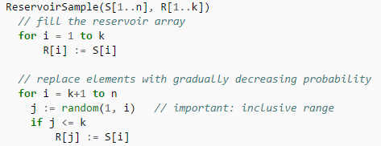
One-Pass Uniform Sampling
Best choice for incremental maintenance
  Low overheads, no random data access
Reservoir Sampling [Vit85]: Maintains a sample S of a fixed-size k
http://www.cs.umd.edu/~samir/498/vitter.pdf
  Add each new item to S with probability M/N, where N is the current number of data items
  If add an item, evict a random item from S
  Instead of flipping a coin for each item, determine the number of items to skip before the next to be added to S

Slide 12
Wavelets
In signal processing community, wavelets are used to break the complicated signal into single component.
Similarly in approximate query processing, wavelets are used to break the dataset into simple component.
Haar wavelet - simple wavelet, easy to understand

Slide 13
One-Dimensional Haar Wavelets
Wavelets: mathematical tool for hierarchical decomposition of functions/signals
Haar wavelets: simplest wavelet basis, easy to understand and implement
  Recursive pairwise averaging and differencing at different resolutions
Resolution Averages Detail Coefficients
3
[2, 2, 0, 2, 3, 5, 4, 4]
----
2
[2, 1, 4, 4]
[0, -1, -1, 0]
1
[1.5, 4]
[0.5, 0]
0
[2.75]
[-1.25]
[2.75, -1.25, 0.5, 0, 0, -1, -1, 0]
Haar wavelet decomposition

Slide 14
Haar Wavelet Coefficients
Using wavelet coefficients one can pull the raw data
Keep only the large wavelet coefficients and pretend other coefficients to be 0.
[2.75, -1.25, 0.5, 0, 0, -1, -1, 0]
[2.75, -1.25, 0.5, 0, 0, 0, 0, 0]-synopsis of the data
The elimination of small coefficients introduces only small error when reconstructing the original data

Slide 15
Haar Wavelet Coefficients
Hierarchical decomposition structure (a.k.a. “error tree”)
Coefficient “Supports”
₊
2.75
₋
2.75
₊
+
-1.25
₋
+
-1.25
-
₊
₋
0.5
₊
0.5
0
0
₋
+
-
+
-
₊
₋
0
0
-1
-1
0
₊
₋
+
-
+
-
+
-
+
-
-1
₊
₋
-1
2 2 0 2 3 5 4 4
₊
0
Original data

Slide 16
Example
Query: SELECTsalary
FROM employee
WHERE empid=5
Result: By using the synopsis [2.75,- 1.25, 0.5, 0, 0, 0, 0, 0] and constructing the tree on fly, salary=4 will be returned, whereas the correct result is salary=3.
This error is due to truncation of wavelength
Employee
Empid | Salary
1 2 3 4 5 6 7 8 | 2 2 0 2 3 5 4 4
+
2.75
+
-1.25
-
+
-
0.5
+
0
-
+
0
0
0
0
-
+
-
+
-
+
-
4

Slide 17


Example-2 on range query
SELECT sum(salary) FROM Employee WHERE 3 <= empid <=7
Find the Haar wavelet transformation and construct the tree
where
Result: (6-2+1)*2.75 + (2-3)* (-1.25) – 2*0.5 = 14
Empid | Salary
1 2 3 4 5 6 7 8 | 2 2 0 2 3 5 4 4
c0
Employee
2.75
+
c1
+
-1.25
-
c2
c3
+
-
0.5
+
0
-
+
0
+
0
0
0
-
-
+
-
+
-
Synopses for Massive Data: Samples, Histograms, Wavelets, Sketches, Graham, et.al http://db.ucsd.edu/static/Synopses.pdf

Slide 18
Comparison with sampling
For Haar wavelet transformation all the data must be numeric. In the example, even empid must be numeric and must be sorted
Sampling gives the probabilistic error measure whereas Haar wavelet does not provide any
Haar wavelet is more robust than sampling. The final average gives the average of all data values. Hence all the tuples are involved.

Slide 19
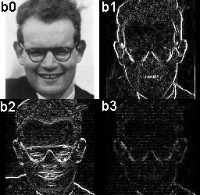

https://www.sciencezero.org/index.php?title=Haar_wavelet_(2x2)

Slide 20
Graph data synopsis

Slide 21
Graph Data Synopses
Graph synopses
  Small synopses of big graphs
  Easy to construct
  Yield good approximations of the relevant properties of the data set
Types of synopses
  Neighborhood sketches
  Graph Sampling
  Sparsifiers
  Spanners
  Landmark vectors
  …

Slide 22
Landmarks for distance queries
Offline
  Precompute distance of all nodes to a small set of nodes (landmarks)
  Each node is associated with a vector with its SP-distance from each landmark (embedding)
Query-time
  d(s,t) = ?
  Combine the embeddings of s and t to get an estimate of the query

Slide 23
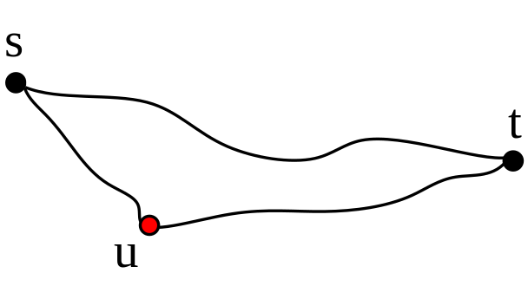
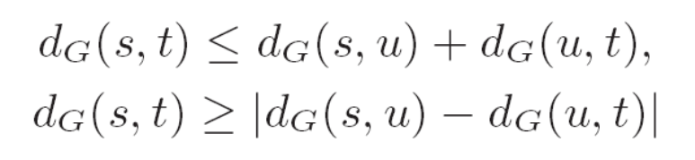
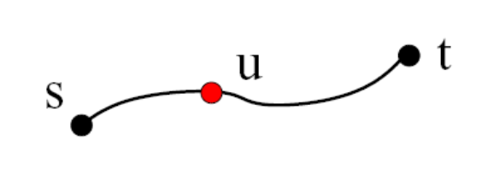




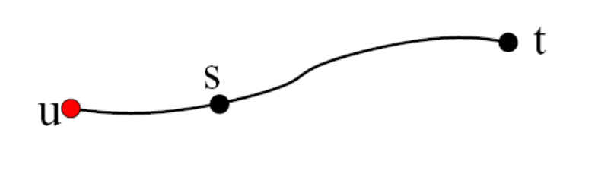
Synopsis for distance/reachability test
Triangle Inequality
Observation: the case of equality

Slide 24
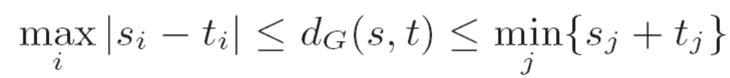
Example query: d(s,t)
 | d(_,u₁) | d(_,u₂) | d(_,u₃) | d(_,u₄)
s | 2 | 4 | 5 | 2
t | 3 | 5 | 1 | 4
UB | 5 | 9 | 6 | 6
LB | 1 | 1 | 4 | 2

Slide 25
Coverage Using Upper Bounds
A landmark u covers a pair (s, t), if u lies on a shortest path from s to t
Problem Definition : find a set of k landmarks that cover as many pairs (s,t) in V x V
  NP-hard
  k = 1 : node with the highest betweenness centrality
  k > 1 : greedy set-cover (too expensive)
How to select? Random; high centrality; high degree, high Pagerank scores…

Slide 26
The Landmark Method
Selection: Select k landmarks
Offline: Run k BFS/Dijkstra and store the embeddings of each node:
  Φ(s) = <d_{G}(u₁, s), d_{G}(u₂, s), … , d_{G}(u_{k}, s)>
  = <s₁, s₂, …, s_{d}>
Query-time: d_{G}(s,t) = ?
  Fetch Φ(s) and Φ(t)
  Compute min_{i}{s_{i} + t_{i}}... in time O(k)
2
3
…
2
…
4
lm₁
lm₂
…
lmi
…
lmk
4
1
…
1
…
4

Slide 27
Spanners
Let G be a weighted undirected graph.
A subgraph H of G is a t-spanner of G iff ∀u,v∈G, δ_{H}(u,v) ≤ t δ_{G}(u,v) .
The smallest value of t for which H is a t-spanner for G is called the stretch factor of H .

Slide 28
How to construct a spanner?
Input : A weighted graph G,
A positive parameter r.
The weights need not be unique.
Output : A sub graph G’.
Step 1: Sort E by non-decreasing weight.
Step 2: Set G’ = { }.
Step 3: For every edge e = [u,v] in E, compute P(u,v), the shortest path from u to v in the current G’.
Step 4: If, r.Weight(e) < Weight(P(u,v)),
add e to G’,
else, reject e.
Step 5:Repeat the algorithm for the next edge in E and so on.

Slide 29
Approximate Distance Oracles
Consider a graph G=(V,E). An approximate distance oracle with a stretch k for the graph G is a data-structure that can answer an approximate distance query for any two vertices with a stretch of at most k.
For every u,v in V the data structure returns in “short time” an approximate distance d’ such that:
d_{G}(u,v) ≤ d’ ≤ k· d_{G}(u,v)
A k-spanner is a k distance oracle
Theorem: One can efficiently find a (2k-1)-spanner with at most n^{1+1/k} edges.

Slide 30
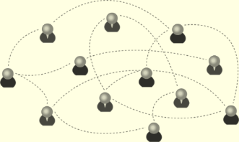
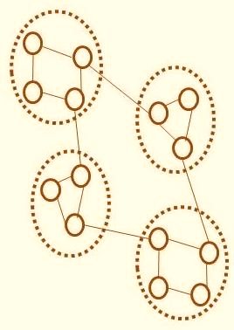

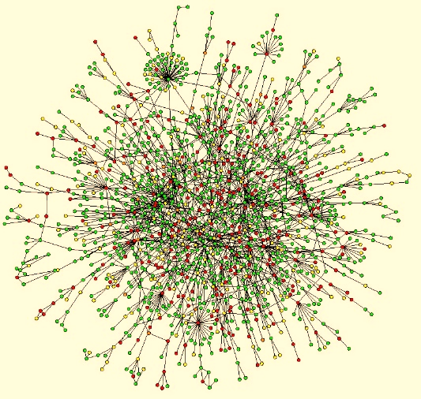
Graph Sparsification
Is there a simple pre-processing of the graph to reduce the edge set that can “clarify” or “simplify” its cluster structure?
Application: graph community detection

Slide 31

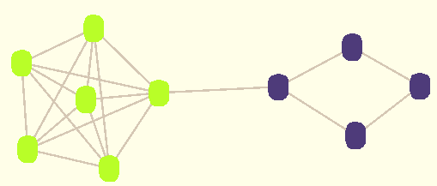
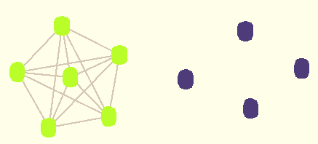
Global Sparsification
Parameter: Sparsification ratio, s
  For each edge <i,j>: calculate Sim ( <i,j> )
  Retain top s% of edges in order of Sim, discard others
Dense clusters: over-represented;
sparse clusters: under-represented

Slide 32
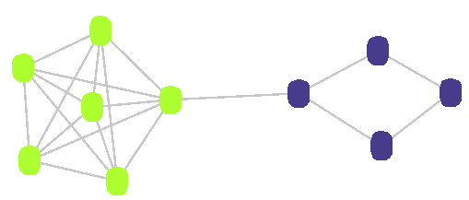
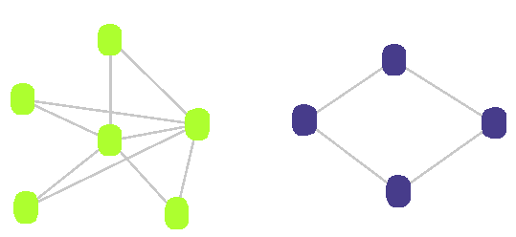
Local Sparsification
“Local Graph Sparsification for Scalable Clustering”, Venu Satulur et.al, SIGMOD 11
Parameter: Sparsification exponent, e (0 < e < 1)
For each node i of degree d_{i}:
    For each neighbor j:
        Calculate Sim ( <i,j> )
    Retain top (d_{i})^{e} neighbors in order of Sim, for node i
Ensures representation of clusters of varying densities

Slide 33
Applications of Sparsifiers
Faster (1 ± ε)-approximation algorithms for flow-cut problems
  Maximum flow and minimum cut [Benczur-Karger 02, …, Madry 10]
  Graph partitioning [Khandekar-Rao-Vazirani 09]
Improved algorithms for linear system solvers [Spielman-Teng 04, 08]
Sample each edge with a certain probability
  Non-uniform probability chosen captures “importance” of the cut (several measures have been proposed)
  Distribution of the number of cuts of a particular size [Karger 99]
  Chernoff bounds

Slide 34
Summing up

Slide 35
Approximate query answering
Challenges: to get real-time answers
Big data and costly queries
Limited resources
Two approaches:
Query-driven approximation
  Cheaper queries
  Retain sensible answers
Data-driven approximation
  6 type of data synopses construction methods
  (histogram, sample, wavelet, sketch, spanner, sparsifier)
  Dynamic data reduction
  Query-guided search
Combined with techniques for making big data small
Reduce data of PG size to GB
Query big data within bounded resources

Slide 36
Summary and review
What is query-driven approximation? When can we use the approach?
Traditional approximation scheme does not work very well for query answering in big data. Why?
What is data-driven dynamic approximation? Does it work on localized queries? Non-localized queries?
What is query-guided search?
Think about the algorithm you will be designing for querying large datasets. How can approximate querying idea applied?

Slide 37
Papers for you to review
G. Gou and R. Chirkova. Efficient algorithms for exact ranked twig-pattern matching over graphs. In SIGMOD,
2008. http://dl.acm.org/citation.cfm?id=1376676
H. Shang, Y. Zhang, X. Lin, and J. X. Yu. Taming verification hardness: an efficient algorithm for testing subgraph isomorphism. PVLDB,2008. http://www.vldb.org/pvldb/1/1453899.pdf
R. T. Stern, R. Puzis, and A. Felner. Potential search: A bounded-cost search algorithm. In ICAPS, 2011. (search Google Scholar)
S. Zilberstein, F. Charpillet, P. Chassaing, et al. Real-time problem solving with contract algorithms. In IJCAI, 1999. (search Google Scholar)
W. Fan, X. Wang, and Y. Wu. Diversified Top-k Graph Pattern Matching, VLDB 2014. (query-driven approximation)
  W. Fan, X. Wang, and Y. Wu. Querying big graphs with bounded resources, SIGMOD 2014. (data-driven approximation)

